Slide 1
⁵⁸Ni + ⁹⁶Ru 实验数据处理

Slide 2
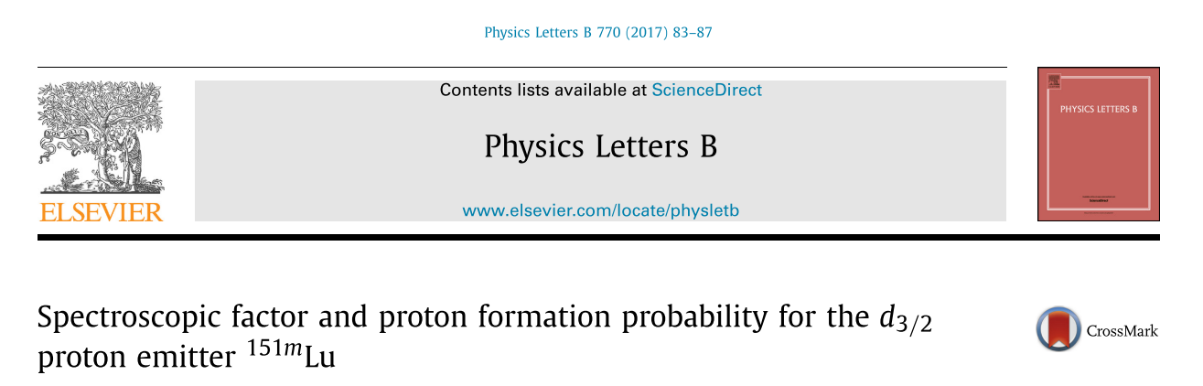
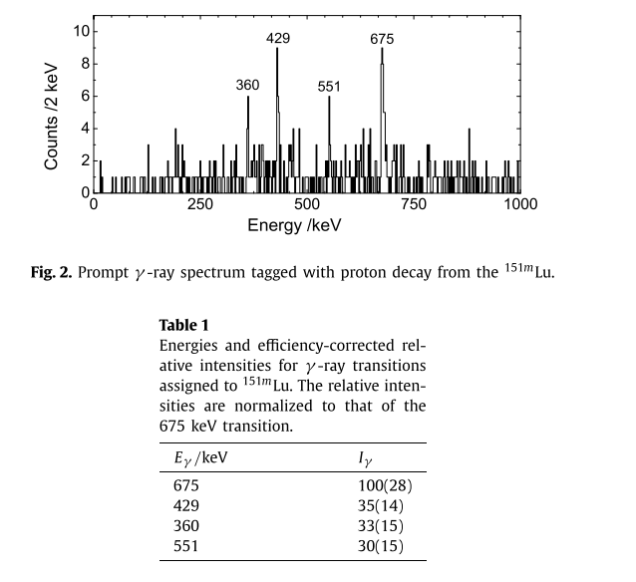
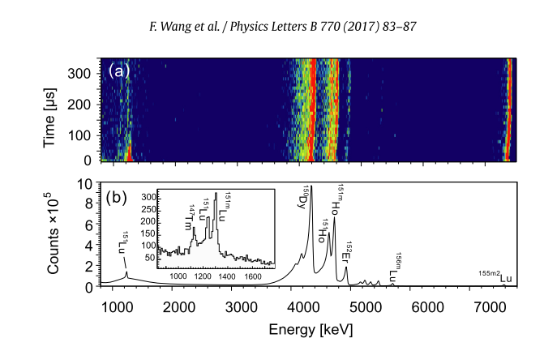
¹⁵¹Lu（实验目的1：isomer质子发射）

Slide 3
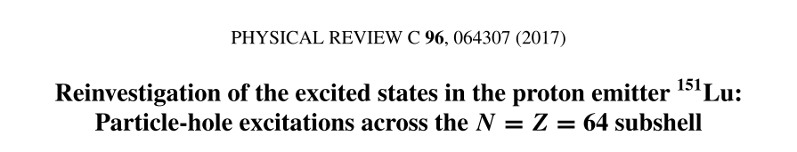
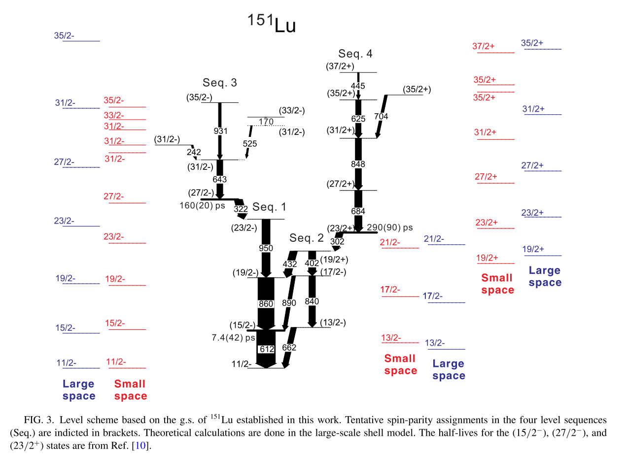
¹⁵¹Lu（实验目的1：结构研究）

Slide 4
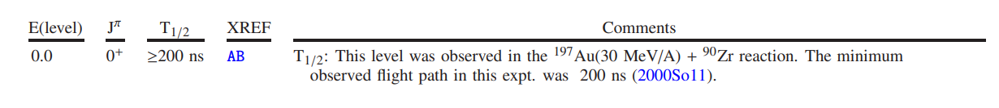
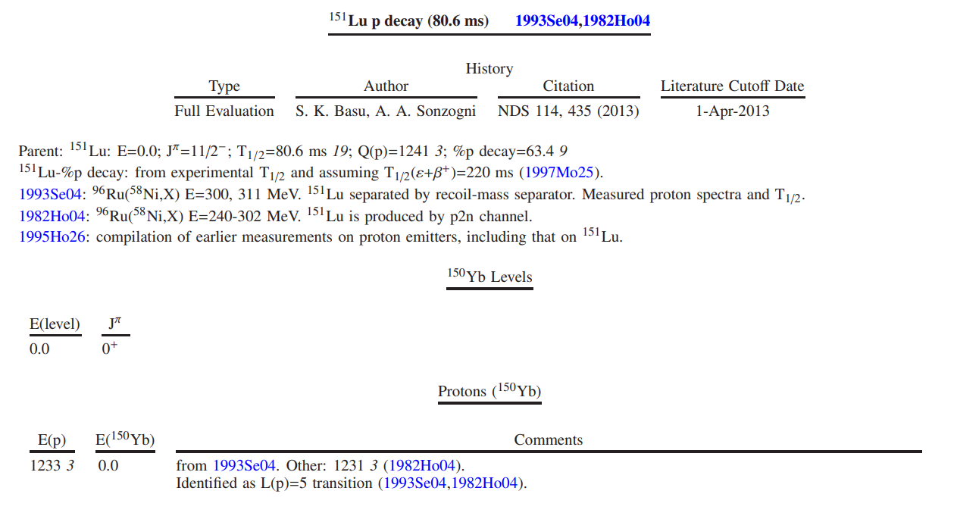
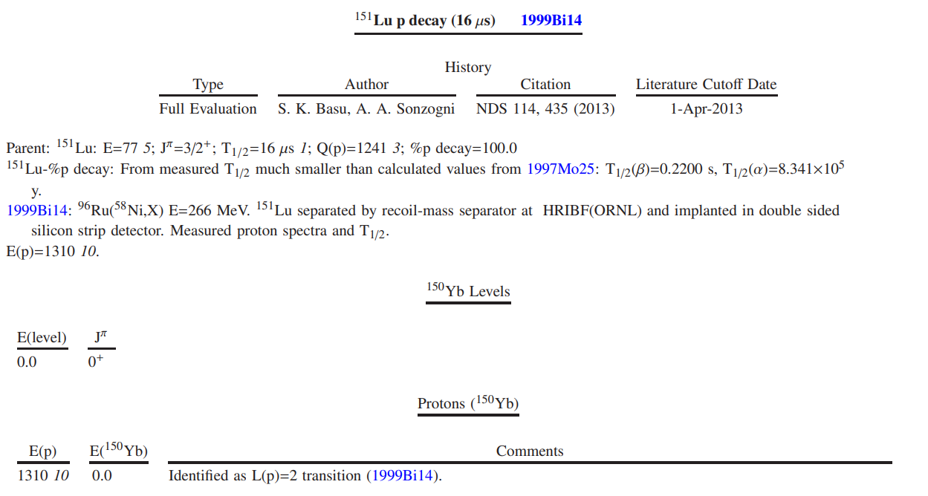
¹⁵⁰Yb（实验目的2：研究其衰变和结构）

Slide 5
¹⁵⁰Yb （实验目的2：找10+ isomer）

Slide 6
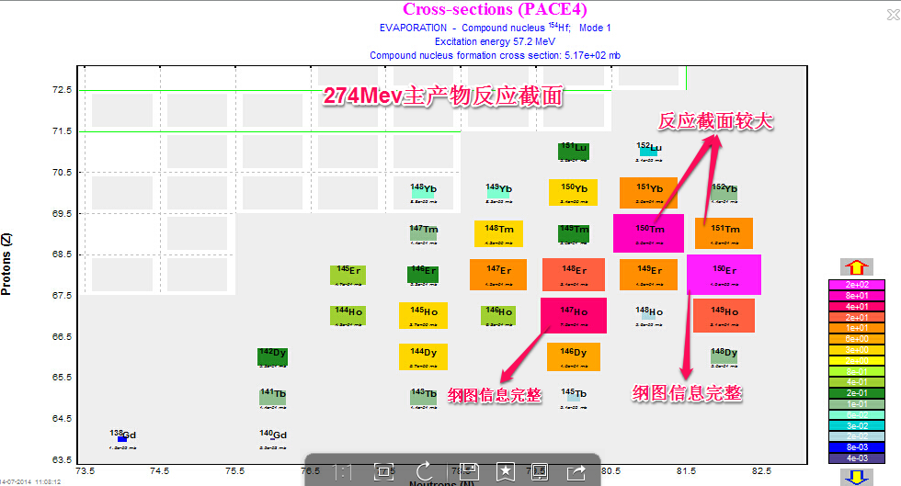
Products
⁵⁸Ni +^{96,99,101,102}Ru →^{154,157,159,160}Hf

Slide 7
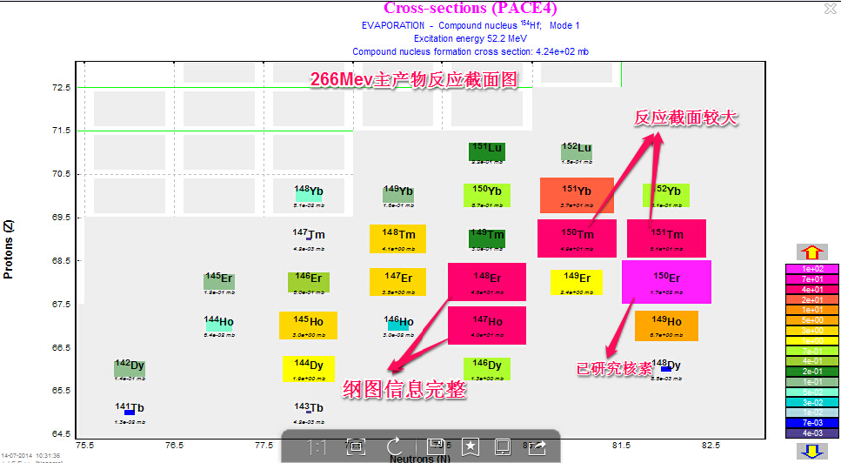
Products
⁵⁸Ni +^{96,99,101,102}Ru →^{154,157,159,160}Hf

Slide 8
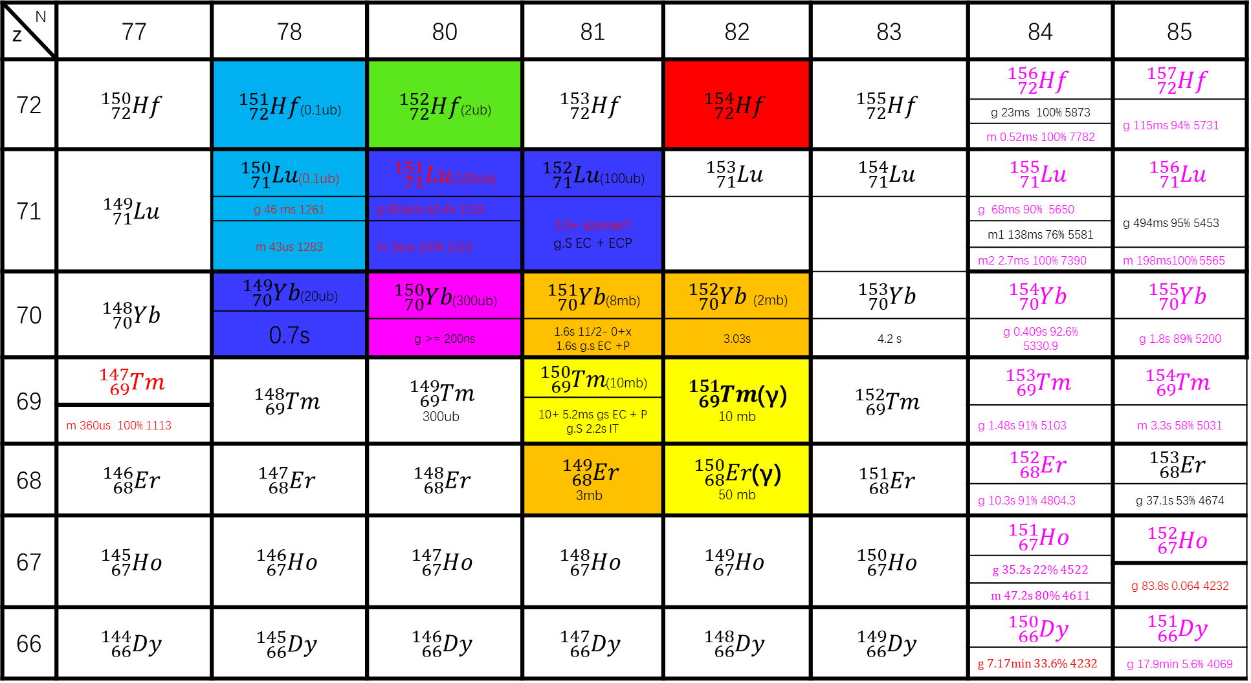
Products
⁵⁸Ni +^{96,99,101,102}Ru →^{154,157,159,160}Hf (266 MeV/274MeV)
N Z | 77 | 78 | 80 | 81 | 82 | 83 | 84 | 85
72 | $${}_{72}^{150}{Hf}$$ | ${}_{72}^{151}{Hf}$(0.1ub) | ${}_{72}^{152}{Hf}$(2ub) | $${}_{72}^{153}{Hf}$$ | $${}_{72}^{154}{Hf}$$ | $${}_{72}^{155}{Hf}$$ | $${}_{72}^{156}{Hf}$$ | $${}_{72}^{157}{Hf}$$
 |  |  |  |  |  |  | g 23ms 100% 5873 | g 115ms 94% 5731
 |  |  |  |  |  |  | m 0.52ms 100% 7782
71 | $${}_{71}^{149}{Lu}$$ | ${}_{71}^{150}{Lu}$(0.1ub) | ${}_{71}^{151}{Lu}$(100ub) | ${}_{71}^{152}{Lu}$(100ub) | $${}_{71}^{153}{Lu}$$ | $${}_{71}^{154}{Lu}$$ | $${}_{71}^{155}{Lu}$$ | $${}_{71}^{156}{Lu}$$
 |  | g 46 ms 1261 | g 80.6ms 63.4% 1233 | 10+ isomer? g.S EC + ECP |  |  | g 68ms 90% 5650 | g 494ms 95% 5453
 |  | m 43us 1283 | m 16us 100% 1310 |  |  |  | m1 138ms 76% 5581
 |  |  | m 16us 100% 1310 |  |  |  | m2 2.7ms 100% 7390 | m 198ms100% 5565
70 | $${}_{70}^{148}{Yb}$$ | ${}_{70}^{149}{Yb}$(20ub) | ${}_{70}^{150}{Yb}$(300ub) | ${}_{70}^{151}{Yb}$(8mb) | ${}_{70}^{152}{Yb}$ (2mb) | $${}_{70}^{153}{Yb}$$ | $${}_{70}^{154}{Yb}$$ | $${}_{70}^{155}{Yb}$$
 |  | 0.7s
 |  |  | g >= 200ns | 1.6s 11/2- 0+x 1.6s g.s EC +P | 3.03s | 4.2 s | g 0.409s 92.6% 5330.9 | g 1.8s 89% 5200
69 | $${}_{69}^{147}{Tm}$$ | $${}_{69}^{148}{Tm}$$ | $${}_{69}^{149}{Tm}$$ 300ub | ${}_{69}^{150}{Tm}$(10mb) | ${}_{69}^{151}{Tm}$(γ) 10 mb | $${}_{69}^{152}{Tm}$$ | $${}_{69}^{153}{Tm}$$ | $${}_{69}^{154}{Tm}$$
 |  |  |  | 10+ 5.2ms gs EC + P g.S 2.2s IT
 | m 360us 100% 1113 |  |  |  |  |  | g 1.48s 91% 5103 | m 3.3s 58% 5031
68 | $${}_{68}^{146}{Er}$$ | $${}_{68}^{147}{Er}$$ | $${}_{68}^{148}{Er}$$ | $${}_{68}^{149}{Er}$$ 3mb | ${}_{68}^{150}{Er}$(γ) 50 mb | $${}_{68}^{151}{Er}$$ | $${}_{68}^{152}{Er}$$ | $${}_{68}^{153}{Er}$$
 |  |  |  |  |  |  | g 10.3s 91% 4804.3 | g 37.1s 53% 4674
67 | $${}_{67}^{145}{Ho}$$ | $${}_{67}^{146}{Ho}$$ | $${}_{67}^{147}{Ho}$$ | $${}_{67}^{148}{Ho}$$ | $${}_{67}^{149}{Ho}$$ | $${}_{67}^{150}{Ho}$$ | $${}_{67}^{151}{Ho}$$ | $${}_{67}^{152}{Ho}$$
 |  |  |  |  |  |  | g 35.2s 22% 4522
 |  |  |  |  |  |  |  | g 83.8s 0.064 4232
 |  |  |  |  |  |  | m 47.2s 80% 4611
66 | $${}_{66}^{144}{Dy}$$ | $${}_{66}^{145}{Dy}$$ | $${}_{66}^{146}{Dy}$$ | $${}_{66}^{147}{Dy}$$ | $${}_{66}^{148}{Dy}$$ | $${}_{66}^{149}{Dy}$$ | $${}_{66}^{150}{Dy}$$ | $${}_{66}^{151}{Dy}$$
 |  |  |  |  |  |  | g 7.17min 33.6% 4232 | g 17.9min 5.6% 4069

Slide 9
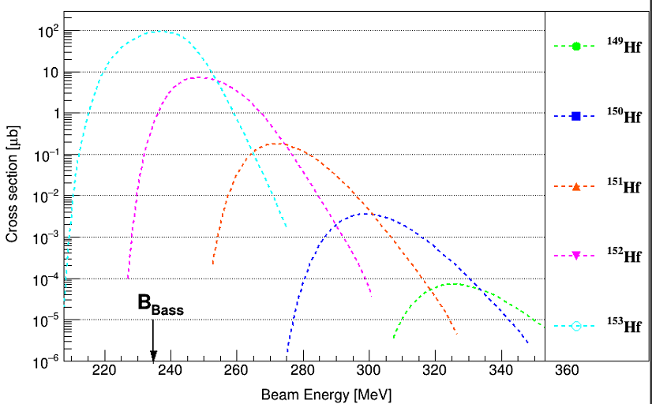
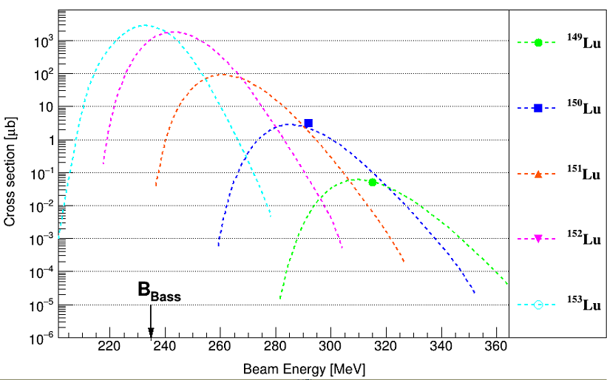
Products
⁵⁸Ni +^{96,99,101,102}Ru →^{154,157,159,160}Hf (266 MeV/274MeV)

Slide 10
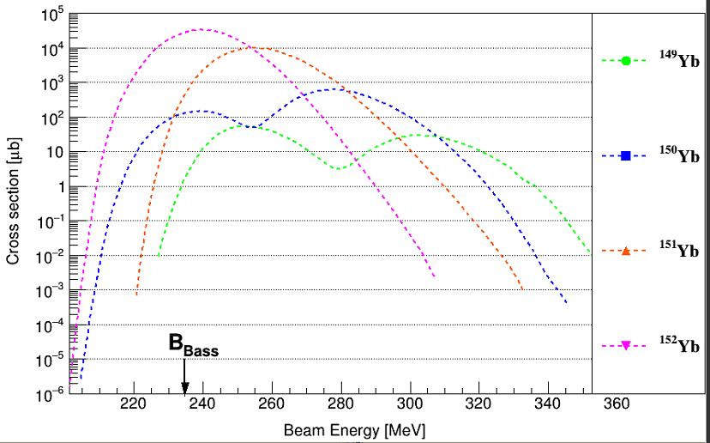
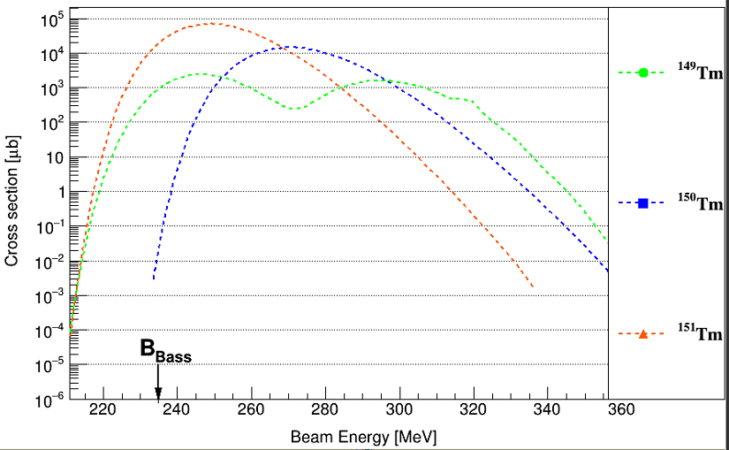
Products
⁵⁸Ni +^{96,99,101,102}Ru →^{154,157,159,160}Hf (266 MeV/274MeV)

Slide 11
Experiment(⁹⁶Ru(⁵⁸Ni, p2n/2p2n)¹⁵¹Lu/¹⁵⁰Yb)
Target: ⁹⁶Ru(0.5mg/cm²)+50ug /cm² · C(reset foil)
Beam energy: 274 MeV, 266MeV *110h
Beam intensity: 3 pnA
Energy in middle of target:
269.5 MeV, 261.5 MeV

Slide 12
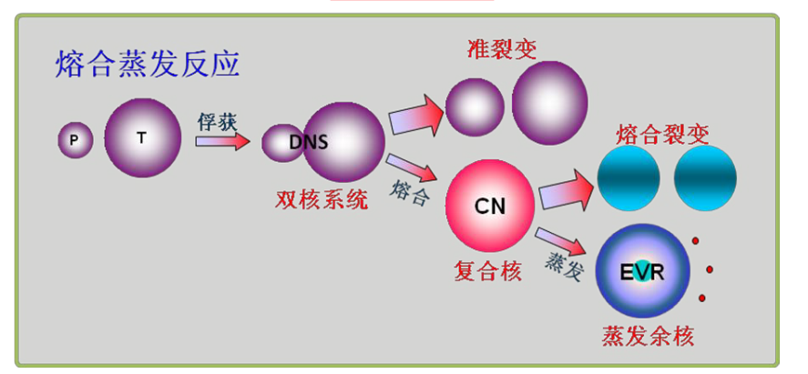
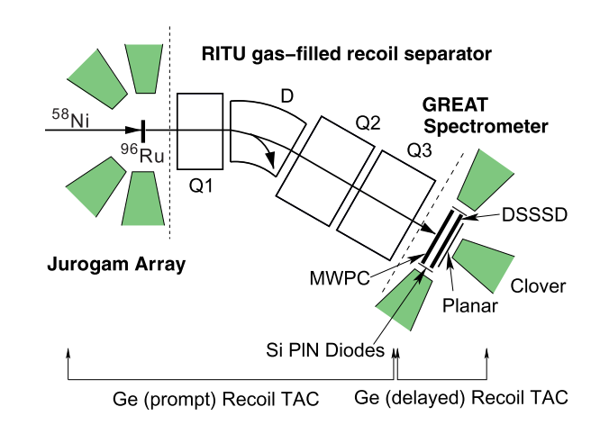
实验设置

Slide 13
多普勒修正

Slide 14
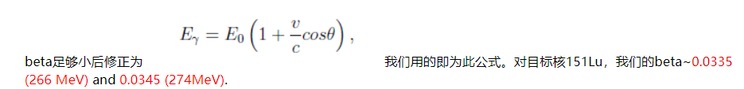
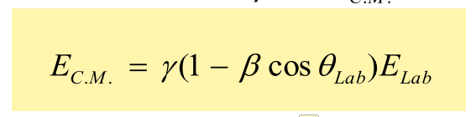
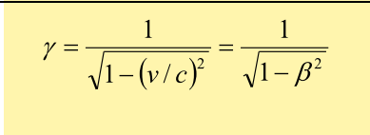
Doppler correction：
Beam Energy | Beam Energy | Compound nucleus
In front of target | In middle of target | Energy | beta | V
266 MeV | 261.5 MeV | 98.487 MeV | 0.03706 | 1.112 cm/ns
274 MeV | 269.53 MeV | 101.511 MeV | 0.03762 | 1.129 cm/ns

Slide 15
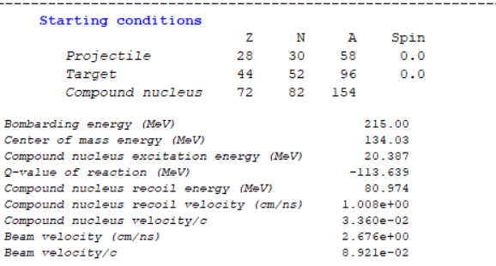
Doppler correction：

Slide 16
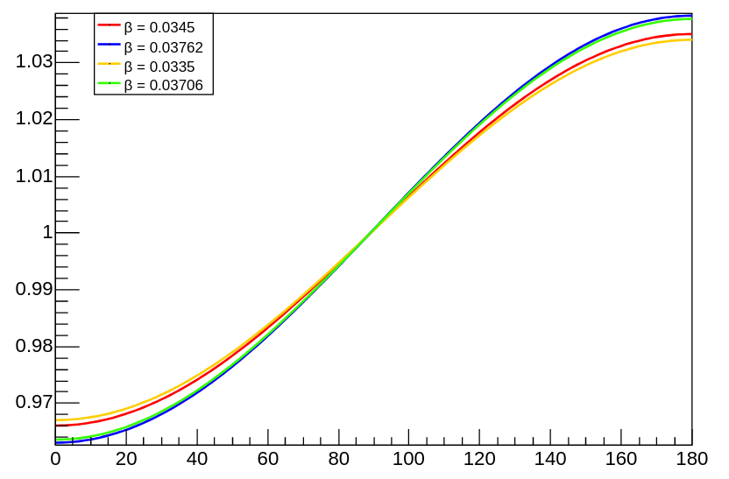
Doppler correction：

Slide 17
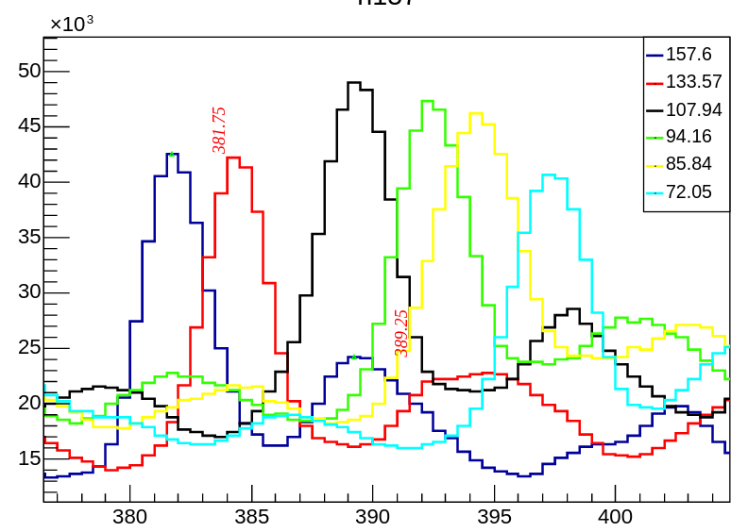
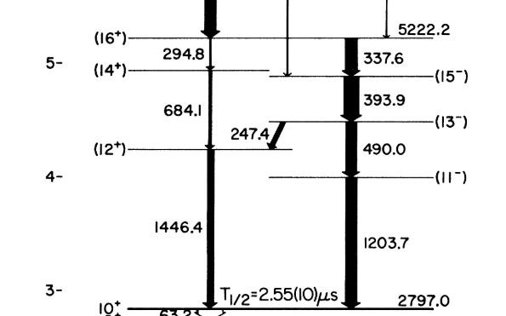
Without Doppler correction：

Slide 18
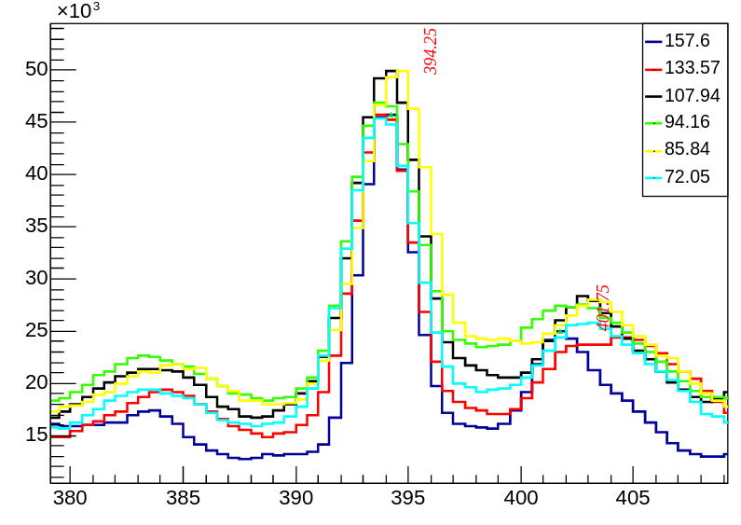
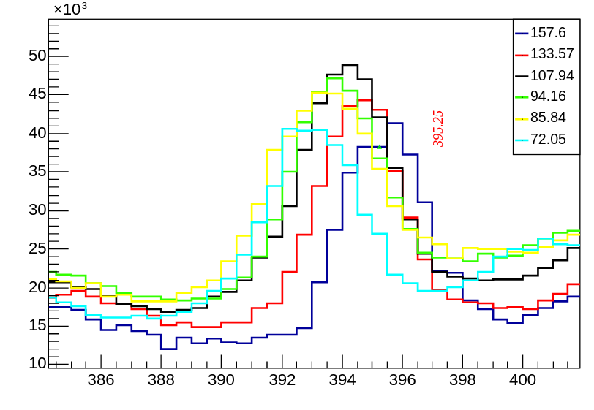
Doppler correction：
使用计算的β值
北航的修正结果

Slide 19
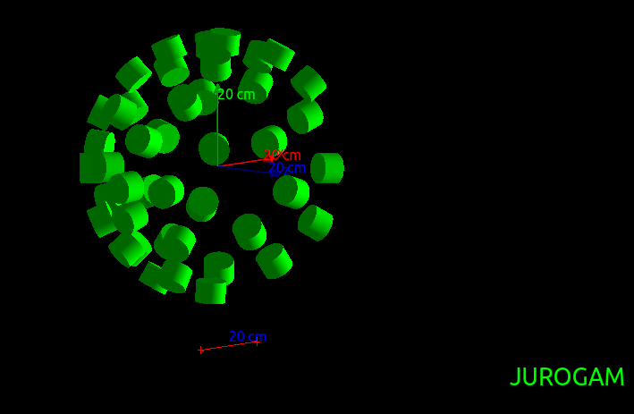
Doppler correction：

Slide 20
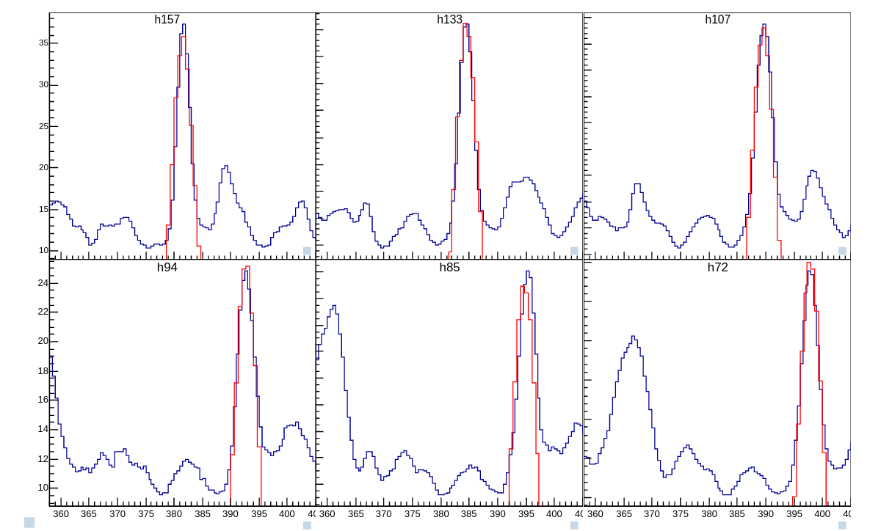
Doppler correction(β=0.0345)：
Geant4 模拟谱
实验谱

Slide 21
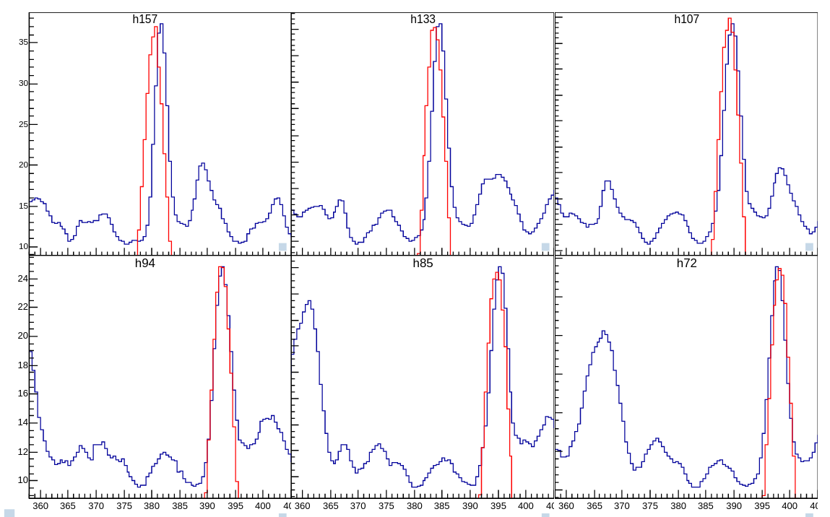
Doppler correction (β=0.03762) ：
Geant4 模拟谱
实验谱

Slide 22
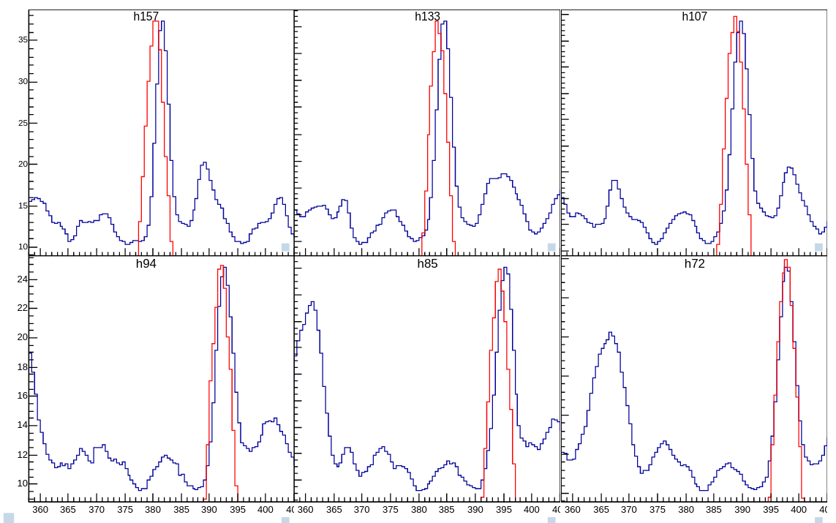
Doppler correction (β=0.03762, z=1cm) ：
Geant4 模拟谱
实验谱

Slide 23
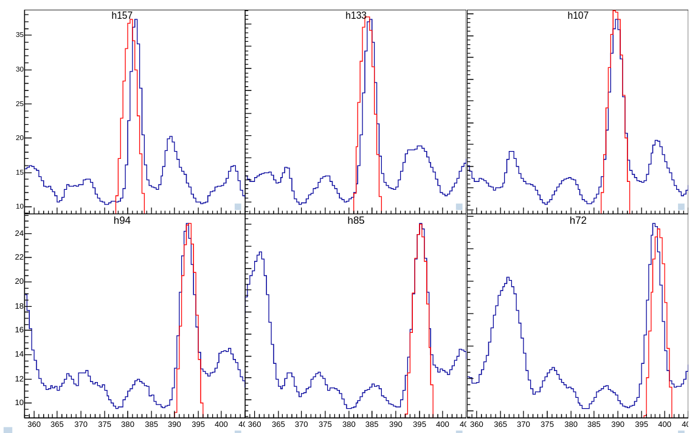
Doppler correction (β=0.03762, z=-1cm) ：
Geant4 模拟谱
实验谱

Slide 24
Doppler correction：
直接刻度

Slide 25
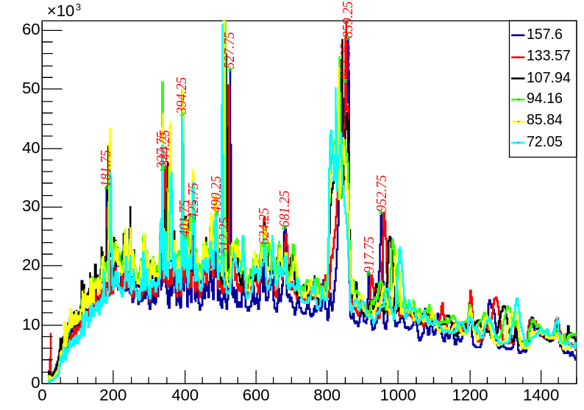
Doppler correction：

Slide 26
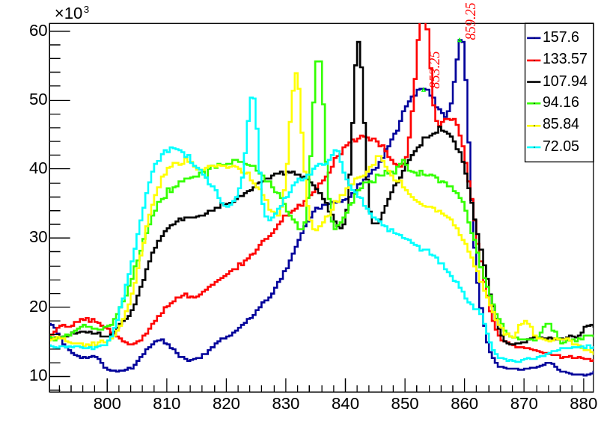
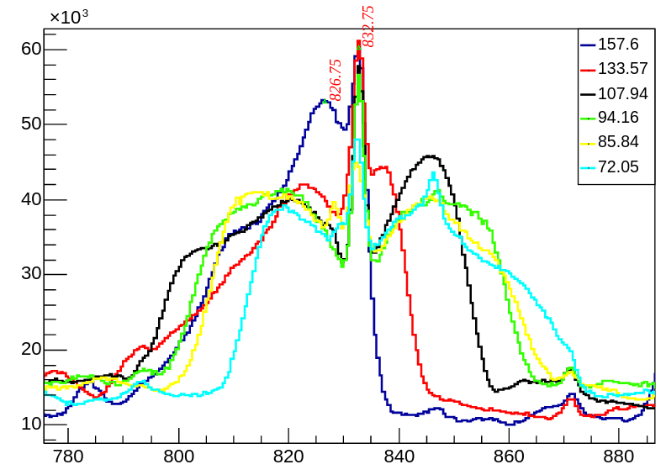
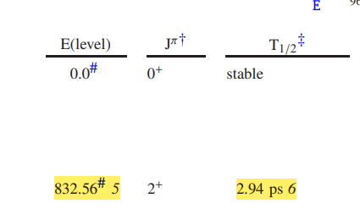
Doppler correction：
96Ru 库伦激发

Slide 27
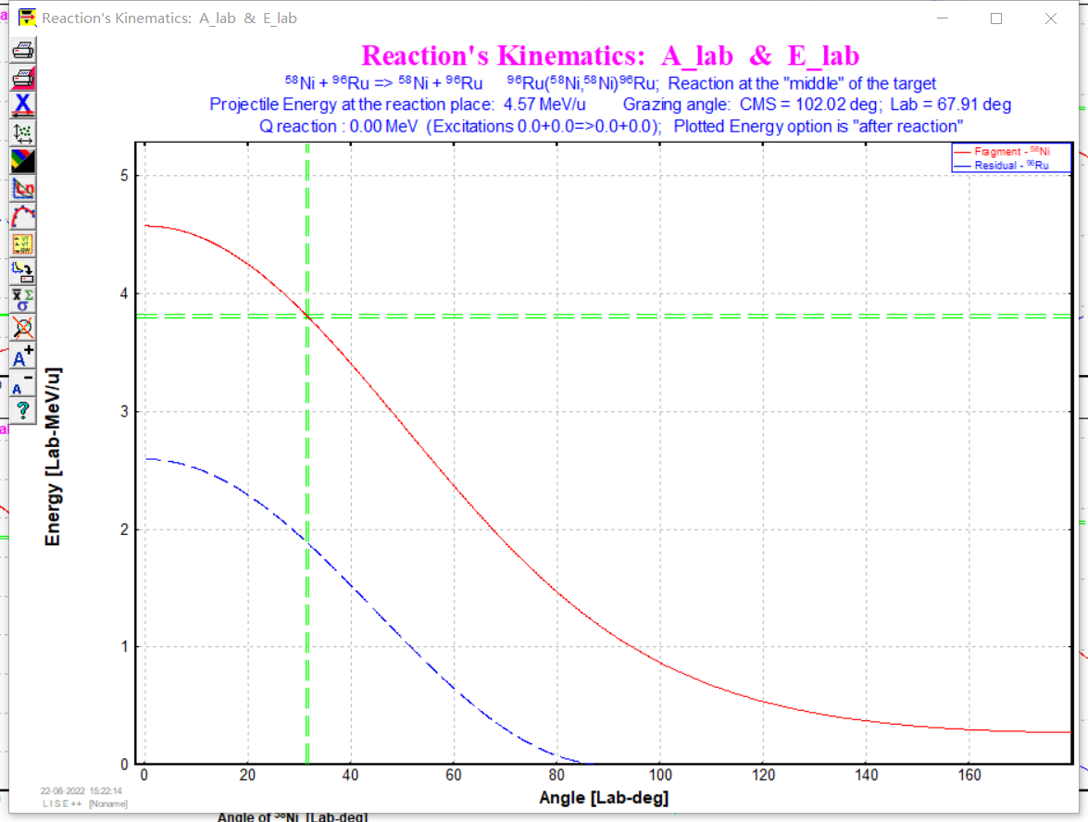
Doppler correction：
静止发射峰
20um/ps → 28um →< 2.8ps
多于一半⁹⁶Ru库伦激发核退激时处于静止状态

Slide 28
Doppler correction：
大角度的高能位移展宽峰
小角度的低能位移展宽峰

Slide 29
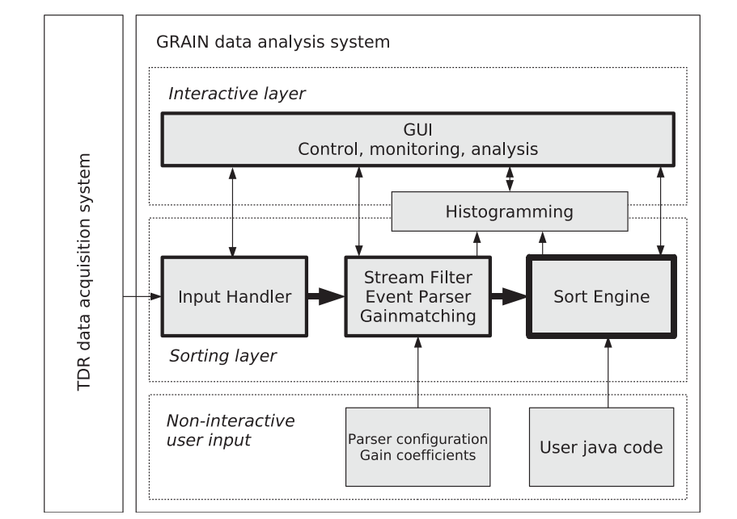
Grain(⁹⁶Ru(⁵⁸Ni, p2n/2p2n)¹⁵¹Lu/¹⁵⁰Yb)

Slide 30
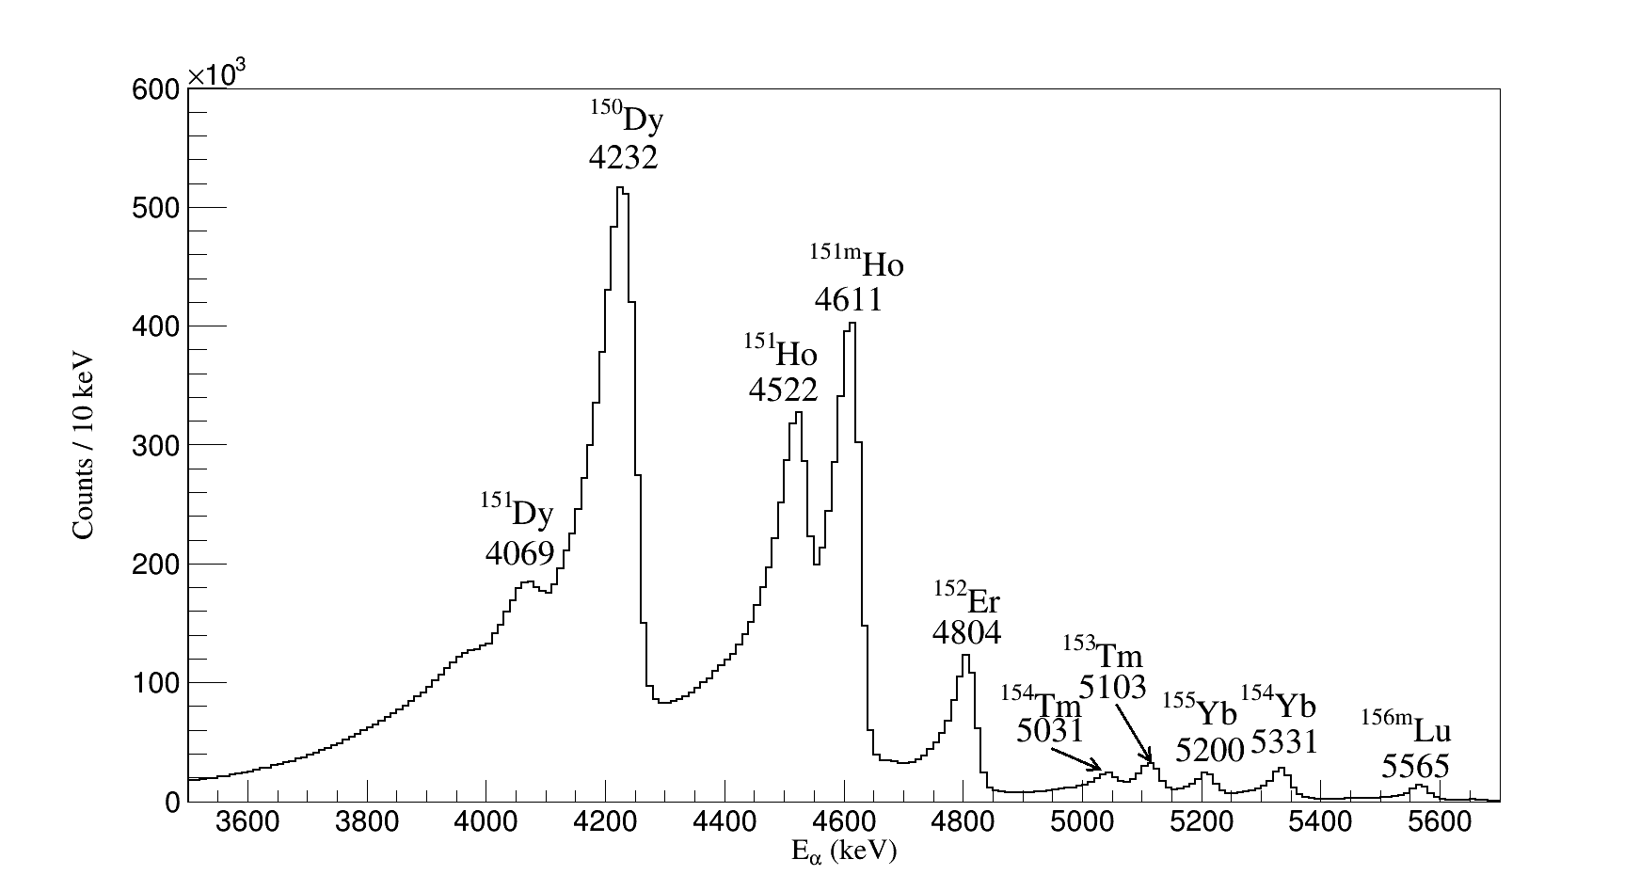
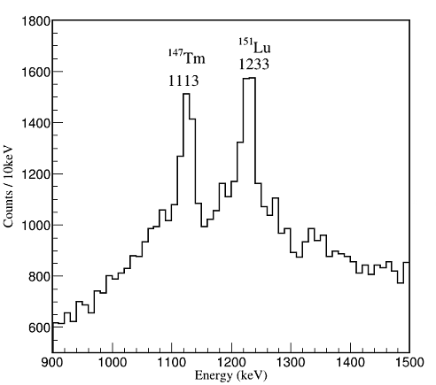
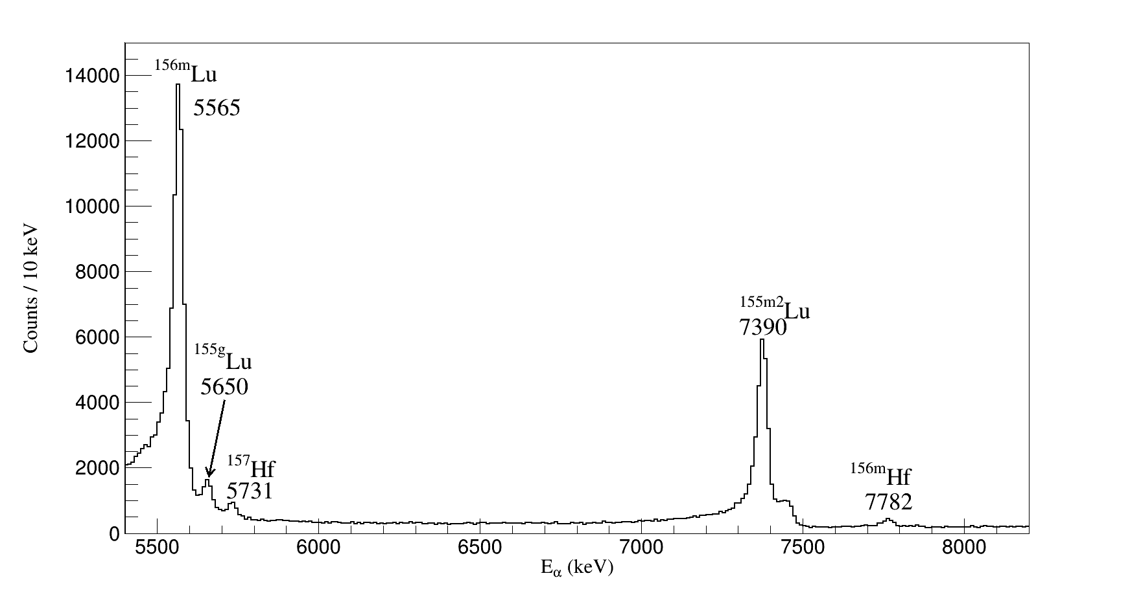
Products
⁵⁸Ni +^{96,99,101,102}Ru →^{154,157,159,160}Hf
α衰变基本都是来自于打杂质来的
只有¹⁴⁷Tm，¹⁵¹Lu是打⁹⁶Ru

Slide 31
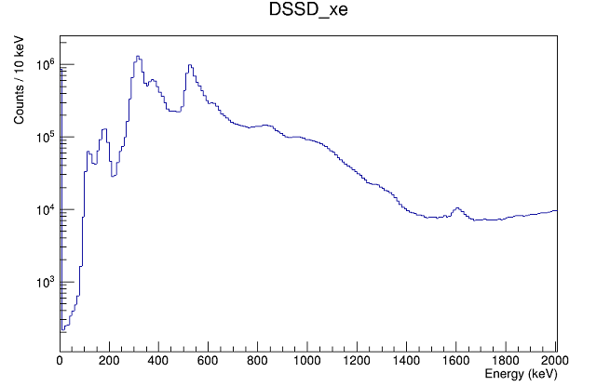
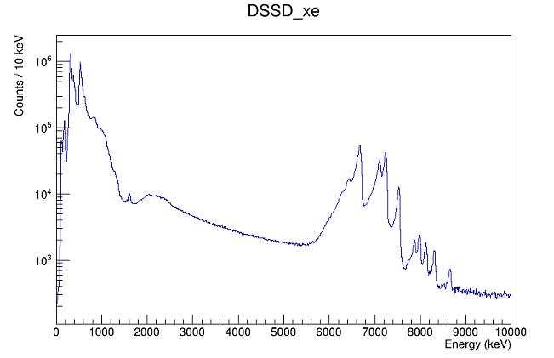
带电粒子谱

Slide 32
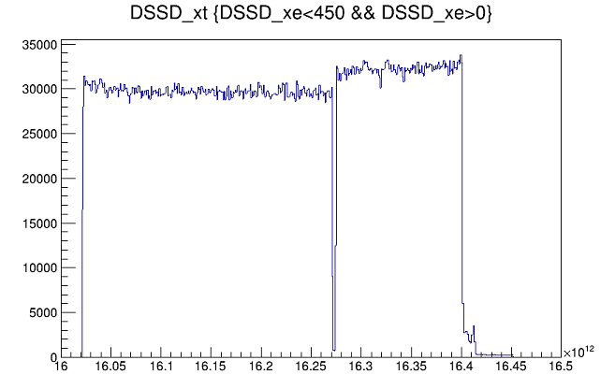
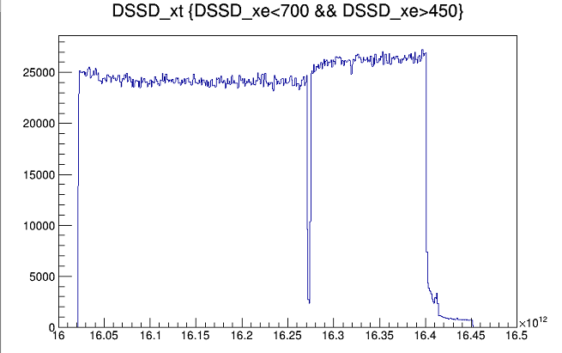
轻粒子计数率

Slide 33
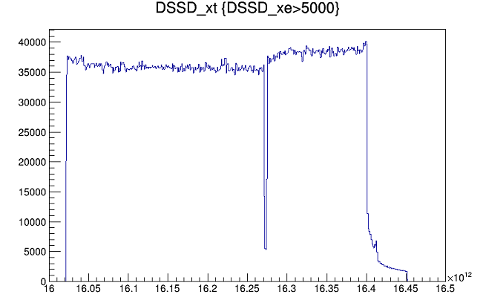
重离子计数率

Slide 34
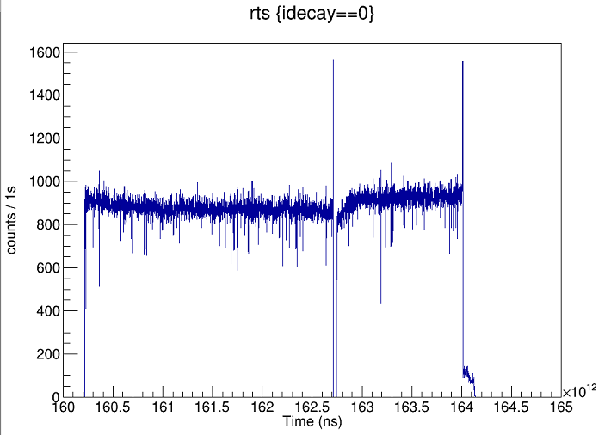
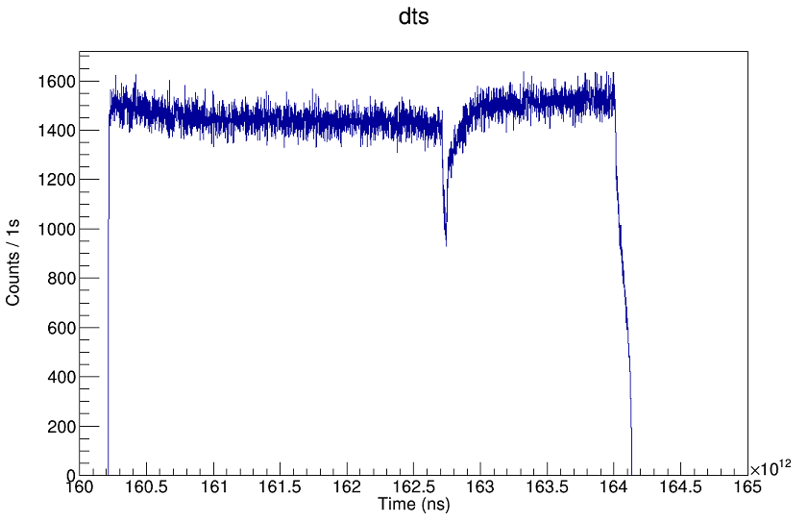
关联到的注入衰变计数率
打到焦平面的融合蒸发产物占总粒子的比例较小
充气谱仪并没有完全把不感兴趣的粒子分离掉，穿过来的还是很多

Slide 35
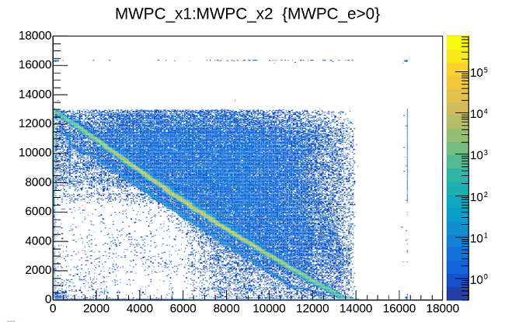
MWPC(⁹⁶Ru(⁵⁸Ni, p2n/2p2n)¹⁵¹Lu/¹⁵⁰Yb)
MWPC有x方向的位置分布信息

Slide 36
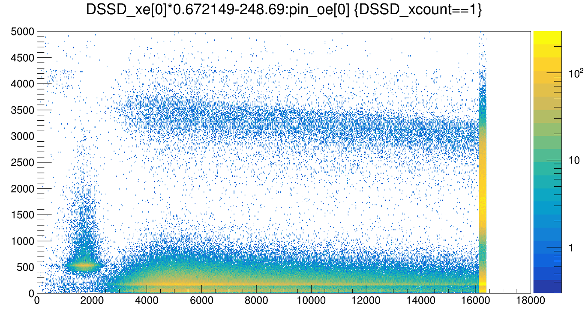
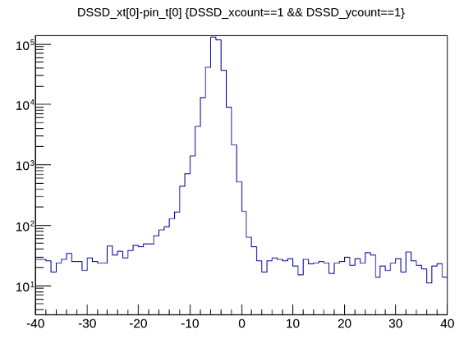
DSSD-Pin
Si二极管探测器前放放大倍数太大或者量程太小，基本都超界，可以用来veto逃逸信号，但是无法找回逃逸能量

Slide 37


MWPC-TOF(MWPC-DSSD)
Recoil: 100 MeV →11MeV(注入关联后得到的结果)
Beam: 266 MeV →11MeV (不太可能是束流造成的)

Slide 38


MWPC-TOF(MWPC-DSSD)-E
TOF和位置无关

Slide 39




MWPC-TOF(MWPC-DSSD)-E
注入核位置分布正常

Slide 40




MWPC-TOF(MWPC-DSSD)-E
怀疑束流的位置，是打偏了

Slide 41


MWPC-TOF(MWPC-DSSD)-E
认为注入的位置，MWPC能量沉积大，确实是反冲核
认为是束流的位置，MWPC能量沉积小，应该是轻核，但不一定是束流

Slide 42


^{产物分布}
1区域之外也存在一半的融合蒸发产物
1
2

Slide 43





^{155m2}Lu(2.69(3)ms)
$$T_{1/2}=2.68\left(2\right)ms$$
1
2
$$T_{1/2}=2.67\left(2\right)ms$$
1区域之外确实是融合蒸发产物，因为提取的半衰期没有问题（注入核有问题半衰期一定有问题，虽然A程序是衰变为主）

Slide 44


¹⁵⁰Yb
150Yb可能的衰变方式为β+，会布局到150Tm的激发态上
但150Tm中已知激发态的自旋和0+相差太大，对应得衰变严格禁戒
Δl>3的β衰变基本没有
结论：通过β衰变到子核的激发态退激的γ线鉴别的路线走不通

Slide 45

¹⁵⁰Yb
可能是直接产生的151Tm

Slide 46



¹⁵⁰Yb

Slide 47


¹⁵⁰Yb

Slide 48


¹⁵⁰Yb
可能是直接产生的151Tm
Δl>3的β衰变基本没有
结论：通过β衰变到子核的激发态退激的γ线鉴别的路线走不通

Slide 49
In beam

Slide 50



Inbeam Study
$${}_{}^{150}{Er}$$
${}_{}^{151}{Tm}$

Slide 51




Inbeam Study
${}_{}^{151}{Tm}$
$${}_{}^{150}{Er}$$

Slide 52


Inbeam Study(¹⁵¹Tm)
$${}_{}^{150}{Er}$$

Slide 53
Inbeam Study(¹⁵¹Tm)
$${}_{}^{150}{Er}$$

Slide 54


Inbeam Study(¹⁵¹Tm) (212 keV)
$$212$$

Slide 55

Inbeam Study(¹⁵¹Tm) (212 keV)
$$212$$

Slide 56



Inbeam Study(¹⁵¹Tm) (212 - 385 keV)
$$385$$
$$212$$
应该有其他来源

Slide 57


Inbeam Study(¹⁵¹Tm) (335 - 393 keV)

Slide 58

Isomer(¹⁵¹Tm)--Clover
198,232 ??

Slide 59

Isomer(¹⁵¹Tm)(232 keV) --Clover

Slide 60

Isomer(¹⁵¹Tm)(198 keV) --Clover

Slide 61


Isomer(¹⁵¹Tm)— PGe-X

Slide 62


Inbeam Study(¹⁵⁰Er)

Slide 63

Inbeam Study(¹⁵⁰Er)

Slide 64

Isomer(¹⁵⁰Er)--Clover

Slide 65

Isomer(¹⁵⁰Er)— PGe-X

Slide 66
¹⁵⁰Yb

Slide 67

¹⁵⁰Yb — PGe-X
156keV、182keV ?

Slide 68





${}_{69}^{151}{{Tm}_{82}^{}}$（Inbeam）
$$πh_{11/2}^{5}$$
$${11/2}^{−}$$

Slide 69


Inbeam Study(¹⁵¹Tm)(Δt~60ns)

Slide 70

Inbeam Study(¹⁵¹Tm)

Slide 71






Inbeam Study(¹⁵¹Tm)(Δt~60ns (v=1.19 cm/ns))
$$<7700∗0.09∗1.0\sim 690(60ns)$$
$$<7700∗0.17∗1.0\sim 1300(120ns)$$
$$7700$$
138、338 keV
计数高
探测效率
$$1500$$
$$250$$
$$<7700∗0.17∗0.25\sim 270(120ns)$$

Slide 72

Inbeam Study(¹⁵¹Tm)(205.5 keV)
$$205.5(1451−1245.6)$$

Slide 73





Inbeam Study(¹⁵¹Tm)(205.5 keV)
$$205.5(1451−1245.6)$$
$${}_{}^{150}{Er}(207.6)$$
$$3\%\sim 120ns$$

Slide 74



Inbeam Study(¹⁵¹Tm)
$$564$$
$$533$$
$$486$$
138,338?
$$372$$
$$403$$
$$513$$
$$422$$
$$205.5(1451−1245.6)$$

Slide 75




Inbeam Study(¹⁵¹Tm)
$$564$$
$$533$$
$$486$$
138,338?
$$372$$
$$403$$
$$513$$
$$422$$
$$205.5(1451−1245.6)$$

Slide 76







Inbeam Study(¹⁵¹Tm)
$$564$$
$$533$$
$$486$$
138,338?
$$514$$
$$403$$
$$372$$
$$525(7)$$
$$205.5(1451−1245.6)$$
$$264(5)$$
$$145(4)$$

Slide 77

Inbeam Study(¹⁵¹Tm)(422)
$$564$$
$$533$$
$$486$$
138,338?
$$514$$
$$403$$
$$372$$
$$205.5(1451−1245.6)$$

Slide 78

Inbeam Study(¹⁵¹Tm)(422)
$$564$$
$$533$$
$$486$$
138,338?
$$514$$
$$403$$
$$372$$
$$205.5(1451−1245.6)$$

Slide 79


Inbeam Study(¹⁵¹Tm)
$$564$$
$$533$$
$$486$$
138,338?
$$514$$
$$403$$
$$372$$
$$205.5(1451−1245.6)$$

Slide 80
事件重构的问题

Slide 81



γ-recoil delay coincidence(gate on 1579 )
$${}_{}^{150}{Er}$$
延迟符合时间谱在事件重构窗位置有坑

Slide 82


γ-recoil delay coincidence(gate on 1579 )
$${}_{}^{150}{Er}$$
Clover1除了有坑外，在时间窗内有突起
原因：Clover1的自触发没打开

Slide 83














Event-building
Grain的事件重构方法：特定通道的触发
十六位逻辑控制
$channe$1
$$Time$$
$$channe2$$
$$Time$$
$$channe3$$
$$Time$$
$$trigger$$
$$Time$$
$$Event1$$
$$Event2$$
$$Event3$$
$Event$4
$$Event5$$
0/1 | 1
0/1 | 2
0/1 | 4
0/1 | 8

Slide 84



Map

Slide 85

Trigger
插Clover1的10号采集卡自触发没开

Slide 86





Event-building(XIA/AGAFA 事件重构方法)
$channe$1
$$Time$$
$$channe2$$
$$Time$$
$$channe3$$
$$Time$$
$$trigger$$
$$Time$$
$$Event1$$
$$Event2$$
$$Event3$$
$$Event4$$

Slide 87



γ-recoil delay coincidence(gate on 1579 )
$${}_{}^{150}{Er}$$
全部更改为自触发无窗输出
2us事件重构

Slide 88
β delayed proton emitter

Slide 89

β delayed proton emitter

Slide 90



β delayed proton emitter
N=幻数-1的极缺中子核素中普遍存在。

Slide 91

β delayed proton emitter
Z=幻数+2的极缺中子核中普遍存在

Slide 92

β delayed proton emitter
Z=幻数+2的极缺中子核中普遍存在

Slide 93


β delayed proton emitter
¹⁴²Nd(¹²C, 7n)¹⁴⁷Dy
¹⁴⁴Sm(¹²C,7n)¹⁴⁹Er
Helium gas-jet apparatus + Collection box(Si telescope(20um ΔE+300um E) + Ge detector)

Slide 94


β delayed proton emitter
(I_{protron}/I_{679γ} = 1.3E-3) && (679 transition is estimated to be $≲$40% of the total ¹⁴⁷Dy decay strength) → branch ratio ~ 4E-4.
In ¹⁴⁴Sm(¹²C,α5n)¹⁴⁷Dy, ¹⁴⁷Dy produced (679 transition is clearly seen.), together with another proton emitter.

Slide 95


β delayed proton emitter
¹⁴⁷Dy, at first, attributed to the reduced level density associated with both the N =82 shell and Z = 64 subshell closures, but it was later shown that the relevant shell is N =82, since the sharp structure was also observed ¹⁴⁹Er and ¹⁵¹Yb.

Slide 96

β delayed proton emitter
On-line isotope separator OASIS
Implanted in a 50-um Mylar tape and transported within 180 ms to an array of detectors consisting of a Si ΔE-E particle telescope, a HPGe detector, two n-type Ge detectors and a thin plastic ΔE_{β} detector

Slide 97




β delayed proton emitter

Slide 98
Isomeric Decay Tagging

Slide 99

Products
⁵⁸Ni +^{96,99,101,102}Ru →^{154,157,159,160}Hf (266 MeV/274MeV)
N Z | 77 | 78 | 80 | 81 | 82 | 83 | 84 | 85
72 | $${}_{72}^{150}{Hf}$$ | ${}_{72}^{151}{Hf}$(0.1ub) | ${}_{72}^{152}{Hf}$(2ub) | $${}_{72}^{153}{Hf}$$ | $${}_{72}^{154}{Hf}$$ | $${}_{72}^{155}{Hf}$$ | $${}_{72}^{156}{Hf}$$ | $${}_{72}^{157}{Hf}$$
 |  |  |  |  |  |  | g 23ms 100% 5873 | g 115ms 94% 5731
 |  |  |  |  |  |  | m 0.52ms 100% 7782
71 | $${}_{71}^{149}{Lu}$$ | ${}_{71}^{150}{Lu}$(0.1ub) | ${}_{71}^{151}{Lu}$(100ub) | ${}_{71}^{152}{Lu}$(100ub) | $${}_{71}^{153}{Lu}$$ | $${}_{71}^{154}{Lu}$$ | $${}_{71}^{155}{Lu}$$ | $${}_{71}^{156}{Lu}$$
 |  | g 46 ms 1261 | g 80.6ms 63.4% 1233 | 10+ isomer? g.S EC + ECP |  |  | g 68ms 90% 5650 | g 494ms 95% 5453
 |  | m 43us 1283 | m 16us 100% 1310 |  |  |  | m1 138ms 76% 5581
 |  |  | m 16us 100% 1310 |  |  |  | m2 2.7ms 100% 7390 | m 198ms100% 5565
70 | $${}_{70}^{148}{Yb}$$ | ${}_{70}^{149}{Yb}$(20ub) | ${}_{70}^{150}{Yb}$(300ub) | ${}_{70}^{151}{Yb}$(8mb) | ${}_{70}^{152}{Yb}$ (2mb) | $${}_{70}^{153}{Yb}$$ | $${}_{70}^{154}{Yb}$$ | $${}_{70}^{155}{Yb}$$
 |  | 0.7s
 |  |  | g >= 200ns | 1.6s 11/2- 0+x 1.6s g.s EC +P 20 us | 3.03s 30 us | 4.2 s | g 0.409s 92.6% 5330.9 | g 1.8s 89% 5200
69 | $${}_{69}^{147}{Tm}$$ | $${}_{69}^{148}{Tm}$$ | $${}_{69}^{149}{Tm}$$ 300ub | ${}_{69}^{150}{Tm}$(10mb) | ${}_{69}^{151}{Tm}$(γ) 10 mb | $${}_{69}^{152}{Tm}$$ | $${}_{69}^{153}{Tm}$$ | $${}_{69}^{154}{Tm}$$
 |  |  |  | 10+ 5.2ms gs EC + P g.S 2.2s IT
 | m 360us 100% 1113 |  |  |  |  |  | g 1.48s 91% 5103 | m 3.3s 58% 5031
68 | $${}_{68}^{146}{Er}$$ | $${}_{68}^{147}{Er}$$ | $${}_{68}^{148}{Er}$$ | ${}_{68}^{149}{Er}$ 4.8us 3mb | ${}_{68}^{150}{Er}$(γ) 50 mb | $${}_{68}^{151}{Er}$$ | $${}_{68}^{152}{Er}$$ | $${}_{68}^{153}{Er}$$
 |  |  |  |  |  |  | g 10.3s 91% 4804.3 | g 37.1s 53% 4674
67 | $${}_{67}^{145}{Ho}$$ | $${}_{67}^{146}{Ho}$$ | $${}_{67}^{147}{Ho}$$ | $${}_{67}^{148}{Ho}$$ | $${}_{67}^{149}{Ho}$$ | $${}_{67}^{150}{Ho}$$ | $${}_{67}^{151}{Ho}$$ | $${}_{67}^{152}{Ho}$$
 |  |  |  |  |  |  | g 35.2s 22% 4522
 |  |  |  |  |  |  |  | g 83.8s 0.064 4232
 |  |  |  |  |  |  | m 47.2s 80% 4611
66 | $${}_{66}^{144}{Dy}$$ | $${}_{66}^{145}{Dy}$$ | $${}_{66}^{146}{Dy}$$ | $${}_{66}^{147}{Dy}$$ | $${}_{66}^{148}{Dy}$$ | $${}_{66}^{149}{Dy}$$ | $${}_{66}^{150}{Dy}$$ | $${}_{66}^{151}{Dy}$$
 |  |  |  |  |  |  | g 7.17min 33.6% 4232 | g 17.9min 5.6% 4069

Slide 100


^{151,152}Yb

Slide 101


¹⁵²Yb
¹⁵¹Yb
¹⁵⁰Er

Slide 102


¹⁵²Yb

Slide 103

¹⁵²Yb(IDT)

Slide 104


¹⁵¹Yb
19/2⁺
¹⁴⁸Er(257)
1578-1319=259

Slide 105

¹⁵¹Yb
19/2⁺

Slide 106

¹⁵¹Yb
19/2⁺

Slide 107


¹⁴⁹Er

Slide 108

¹⁴⁹Er

Slide 109


¹⁵⁰Tm

Slide 110

¹⁵⁰Tm

Slide 111
¹⁵²Yb IDT

Slide 112



¹⁵²Yb：
1531，1578康普顿散射

Slide 113


¹⁵²Yb (139 keV gate (140.4,¹⁵¹Tm,0.45us))：
需要排除掉短寿命的140

Slide 114


¹⁵²Yb (347 keV gate )：
谱正常，可用于IDT

Slide 115


¹⁵²Yb (312 keV gate )：
谱正常，可用于IDT

Slide 116


¹⁵²Yb (358 keV gate (360,¹⁵⁰Er,2.55us))：
需要排除掉短寿命的360

Slide 117


¹⁵²Yb IDT(347，312，139，359 keV gate）：

Slide 118

¹⁵²Yb IDT(347，312，139，359 keV gate）：

Slide 119

¹⁵²Yb (413，421，541 keV gate）：

Slide 120


¹⁵²Yb (167 keV gate）：

Slide 121

¹⁵²Yb level scheme：
507
667
429
167
523,646
421
540
413

Slide 122
N =82

Slide 123

¹⁵⁰Er：

Slide 124

¹⁵⁰Er：
^{58,60}Ni + ^{92,94}Zr,⁹³Nb,^{92,94,95}Mo(~1 mg/cm²)@225-255 MeV
Recoiling residual nuclei were stopped in an 11mg/cm² ²⁰⁸Pb catcher foil placed 21 cm downstream(~20 ns).
Measurements of γ rays from products deposited on the catcher foil were performed (1 planar and 3 large coaxial GE(Li) detectors).
Studying the decay of isomers with half-lives exceeding 10 ns.

Slide 125


¹⁵⁰Er：
2797-keV, 2.55-us isomer as the πh_{11/2}⁴ ν = 2 10⁺
3⁻ octupole state
¹⁴⁶Gd: 1579 keV ($πh_{11/2}^{}d_{5/2}^{−1}$), involving promotion of a proton across the Z=64 gap.
¹⁴⁸Dy: 1688 keV (1688-1579 =） 109 keV shift ← Pauli interference effect arising from coupling of the 3⁻ excitation to $πh_{11/2}^{2}$ component of the ¹⁴⁸Dy 0⁺ ground state)
¹⁵⁰Er: The excitation of 3⁻ is predicted to be 1579+2*109=1797 keV (1786.3 keV)
¹⁵²Yb: The excitation of 3⁻ is predicted to be 1579+3*109 = 1906 keV (1889.3 keV)

Slide 126

¹⁵⁰Er：

Slide 127

¹⁵⁰Er：
$I^{π}={16}^{+}$: is the highest spin configuration arising from valence protons alone, and higher spin states must involve excitation of the ¹⁴⁶Gd core.
The 17⁻ state with the configuration $πh_{11/2}^{3}g_{7/2}^{−1}$ in ¹⁴⁶Gd (7165 keV) and ¹⁴⁸Dy(6263 keV), in both cases about 3.3 MeV above the$πh_{11/2}^{2}$ 10⁺ state. Hence, the corresponding 17⁻ state in ¹⁵⁰Er should come at about 6.1 MeV(level at 6359 keV seems very probable)
States with spins higher than 17 can be formed by 6qp state.
15-ns isomer at 7372 keV is not easily understood as a pure proton state, it may involve the excitation of one or two neutrons across the N = 82 gap.

Slide 128

¹⁴⁸Dy：
^{32，34}S + ¹²⁰⁻¹²⁴Sn(~2 mg/cm² ,evaporated onto thick lead backings)@129-165 MeV
Pulse separation times between 200 and 5000 ns were selected according to the isomer studied @ Argonne.

Slide 129

¹⁴⁸Dy：

Slide 130

¹⁴⁸Dy：
⁴⁰Ar + ¹¹²Cd(~1 mg/cm² , lead foil)@175,185 MeV
70 ns separation between beam bursts, whose average length was about a few nanoseconds

Slide 131

¹⁴⁸Dy：

Slide 132






$${}_{66}^{148}{Dy}$$
$${}_{68}^{150}{Er}$$
$${}_{70}^{152}{Yb}$$

